Slide 1
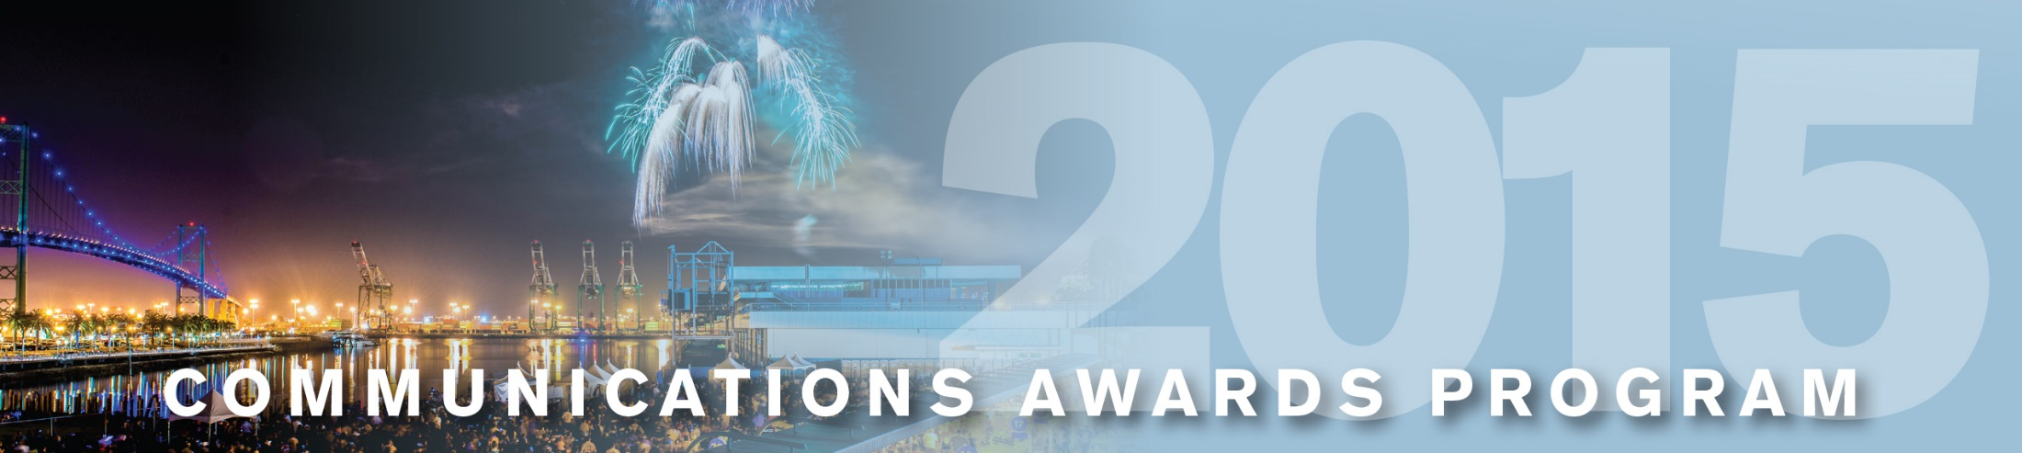
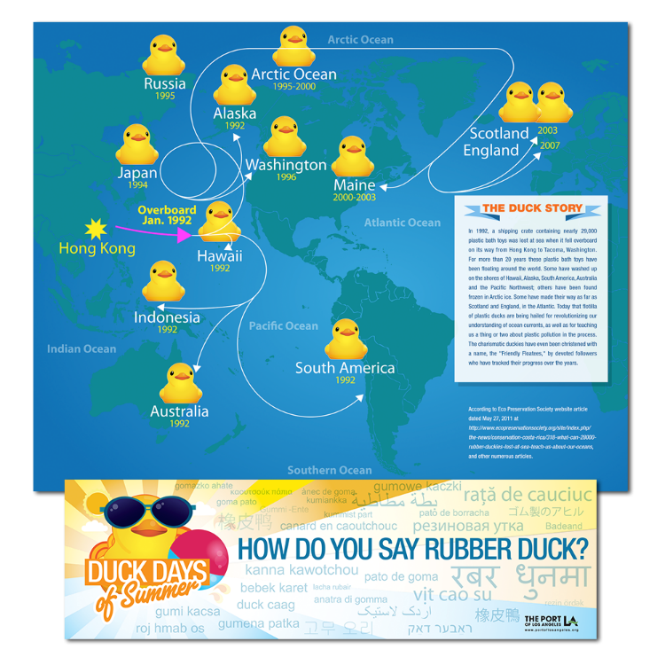
Port of
Los Angeles
Tall Ships Festival LA 2014 Duck Education Program
Miscellaneous

